Slide 1
Week 1
Class 1
Python Basic
Prepared by:
Md. Solaiman Mia

Slide 2
Python Overview
What is Python
Scope of Python
Examples of Software/App/Website that are Developed using Python
Jobs Opportunity (Physical as well as Online)
Python Developer Salaries
Different Fields of Python
Companies that used Python in their Project

Slide 3
What is Python?
Developer: Guido Van Rossum on February 20, 1991
General purpose programming language
Used in variety of fields like AI, ML, DS, DA, web development etc.
Most trended programming language
Easy and simple syntax, readable code
Less write and get more
Interpreted, Object Oriented Programming (OOP) and high level programming language
Can be used to create any types of software or website
Python have powerful libraries to work with variety of different fields like mathematics, engineering, data science, artificial intelligence, machine learning etc.

Slide 4
Scope of Python
Python Trending
Most used programming language in the field of development

Slide 5
Scope of Python
Python Trending
https://www.northeastern.edu/graduate/blog/most-popular-programming-languages/
https://www.simplilearn.com/best-programming-languages-start-learning-today-article
https://towardsdatascience.com/top-10-in-demand-programming-languages-to-learn-in-2020-4462eb7d8d3e?gi=247ba55ec03d
https://statisticstimes.com/tech/top-computer-languages.php

Slide 6
Python Examples
Different application/websites that developed with Python
https://www.botreetechnologies.com/blog/top-15-websites-built-with-python/

Slide 7
Python Job Opportunities
Online / Remotely and Physical Jobs for Python
Python Jobs on Online Market Place Like Fiverr, Upwork, Freelancer etc.
https://www.linkedin.com/jobs/python-jobs?position=1&pageNum=0
https://www.indeed.com/q-Python-Developer-jobs.html
https://www.python.org/jobs/
https://www.glassdoor.com/Job/us-python-jobs-SRCH_IL.0,2_IN1_KO3,9.htm
https://www.ziprecruiter.com/Jobs/Entry-Level-Python-Developer
Freelancing platform
https://www.freelancer.pk/jobs
https://www.fiverr.com
https://www.upwork.com/

Slide 8
Python Developer Salaries
Python Developer Get Highest Salaries
Or If You Start Your Own Business To Get Different Projects Related To Python, You Can Earn More Than Jobs Salaries
Getting start freelancing on fiverr, upwork
Get local projects
Create your website and provide your python services and market
http://www.salaryexplorer.com/salary-survey.php?loc=227&loctype=1&job=6273&jobtype=3
https://www.daxx.com/blog/development-trends/python-developer-salary-usa
https://www.ziprecruiter.com/Salaries/Python-Programmer-Salary

Slide 9
Python Different Fields
Used in Variety of Fields
Artificial Intelligence
Create a system that work, behave and take decision like a human
Data Science
Using different methods to get useful information from unstructured data
Data Analytics
Analysis a data in depth to get useful information to make decision
Machine Learning
The system that give response as it have experience like a human, branch of AI
Web Development
To create website or web applications

Slide 10
Python Different Fields
6) Image Processing or Face Recognition
To process on image to get any type of information using different libraries of Python
7) Video Processing
To perform operations on video frame by frame, or to process on videos
8) Speech Recognition
To create a system in which speech will be recognized to process on that speech
9) Game Development
Python provide powerful libraries to develop high quality games for entertainment

Slide 11
Companies that used Python
Company Name Which Type of Company
Google Search Engine
Google's YouTube Video Search Engine
Intel American manufacturer of semiconductor computer circuits
IBM American multinational technology corporation
NASA U.S. government agency
Pixar American computer animation studio
Netflix American subscription streaming service and production company

Slide 12
Companies that used Python
Company Name Which Type Of Company
Facebook Famous social network
Spotify Swedish Audio streaming and media services
Reddit American social news aggregation,
Pinterest Image sharing social network
Instagram Photo and video sharing social network
JP Morgan Chase American multinational investment bank & financial services company

Slide 13
Python Downloading & Installation
Whether Python is Installed or not in your System
Download and Installation of Python
Difference Between Pyton2 And Python3

Slide 14
Python is Installed or not in your System
Open Command Prompt
Type python and press Enter, you will get Python related information if installed
Lets start to check

Slide 15
Download and Installation of Python
To download python, visit python.org its official website
Then install python to work

Slide 16
Difference between Python2 & Python3
Python2 Released in 2002
Python3 Released in 2008 (latest 3.12.6)
In Python2 print "hello world"
In Python3 print("hello world")
In Python2 int a = 5/2 ->2
In Python3 int a = 5/2 ->2.5
Python2 is the old version
Python3 is the new version
In Python2, raw_input()
In Python3, input()
In Python2, ASCII used to store string
In Python3, UNICODE used to store string
In Python2, Integer size upto 32bit
In Python3, unlimited
In Python2, xrange method
In Python3, range method

Slide 17
Hello World Program in Python
Introduction To IDE
Different IDEs
Hello World Program in Python
Different Ways to Create & Execute Python File
CMD Prompt
Plain Txt File
Notepad++
Vs Code

Slide 18
Introduction To IDE
It is the Integrated Development Environment
It is just a Text Editor in which we Edit Application, Software or Website Source Codes
We can write Source Code, Manage, Test, Debug, Format etc.
Some IDEs provide good feature to Developer, to Develop Application rapidly

Slide 19
Introduction To IDE
Different IDEs
Pydev
Pycharm
Sublime Text
Visual Studio Code
Vim
IDLE
Notepad++ (lightweight, not specific for only Python)

Slide 20
Input and Output Function in Python
Input and Output Function in Python
Python Exercises

Slide 21
Input and Output Function in Python
Input: To get anything from user, we use input() function in Python3
Example:
Name = input(“Enter your name”)
Output: To display anything to user, we use print() function in Python3
Example:
print(Name)

Slide 22
Exercises Related to I/O Function
Get Name from the user and Display
Get Age and Name from the user and Display
Get 2 Numbers from the user and Add both

Slide 23
Important Concepts in Python
Comments
Program & Statement
Terminator
Indentation

Slide 24
Comments in Python
Comments
No Compile
For the developer, not for the user
To write extra about code
To give extra information about the code
Advantages
Easy to understand
Good look
To avoid any execution of statement
Types Comments
Single-line Comment
# single line comment
Multi line Comment
“”” multi line comment “””

Slide 25
What is Program?
A set of instructions that provided to Computer, according to that instruction Computers able to do work
That set of instructions is called Program
With Program, Computer understands that what to Do and how to Do
Computer Programs can be written using Programming Language

Slide 26
What is Statement?
Statement is the complete action in the program
Statement may be a series of bits
We have to separate a statement using semicolon (’;’) on single line
Statement are similar a sentence in the English
Statement may contain variables, I/O function, methods etc.

Slide 27
Statement Examples
name = “Faisal”
age = 30
print(“How are you")
print(name)
print(age)

Slide 28
Terminator / Separator
In the python, there is separator used to separate statement to each other.
The semicolon used as separator in python.
We can write multiple statement on the single
Examples:
print("Hi"); print("How“) # error free
print("Hi") print("How“) # give error

Slide 29
Terminator / Separator
There is no need to use Terminator in Python
a = 45
b = 50
print('No Semicolons ; in the Python')
But in other Programming Languages like C++
a = 45;
b = 50;
cout<<“There is Semicolons ; in the C++”;

Slide 30
Indentation in Python
Indentation means a Properly Distance between Statements
Using Indentation, we can make a specific Block of Code
We cannot make a Group of Statements using Curly Braces in Function, Loop etc.
But we will use a proper Indentation to make a Group of Statements in a Block
Raise Indentation Error
print()
print()

Slide 31
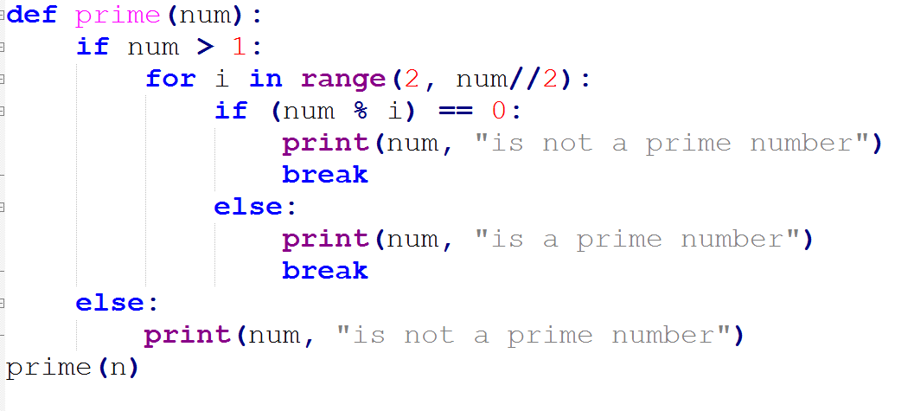
Indentation

Slide 32
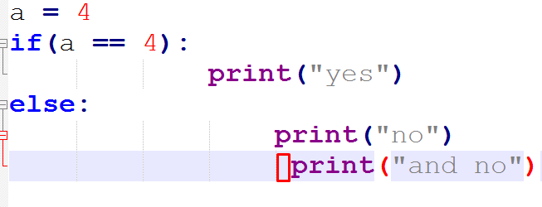
Indentation

Slide 33
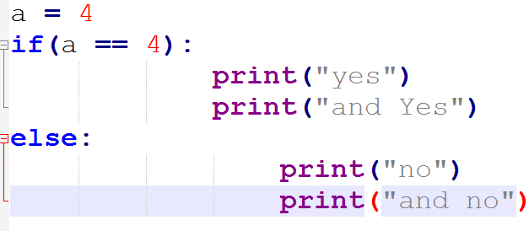
Indentation

Slide 34
Variables in Python
What is Variables
Rules to Declare a Variable
Declaration and Initialization
What is Expression
Undefined Variable (variable name is not defined )
Types of Variable

Slide 35
What is Variables
Variable value may change during the program execution
Variable is the container like thing, which contain anything
Variable is the identifier, you have to declare and then initialize
Example:
a = 12
b = 23.4
name = “Faisal Hossain”
print(name)
print(b)
print(a)

Slide 36
Rules to Declare a Variable
No Space between two words
No Special Character except _
Collection of Alphanumeric
No Reserved Words
May be use of Number in Variable
No Number at the beginning
Case Sensitivity

Slide 37
Declaration and Initialization
Declaration:
When we write a Name of variable according to rules and regulation without providing a Value, is called Declaration of Variable.
Initialization:
After Declaration, you need to provide a Value to the declared variable.
To Assigning a Value to Variable is called Initialization
But in Python, we do not need to declare a variable separately.
At time of the declaration, we provide Value to that variable

Slide 38
Declaration and Initialization
But in other Programming Languages like C++
int a; // Declaration
a = 10; // Initialization
In Python
Example:
a = 10 # Declaration and Initialization
b = 20 # Declaration and Initialization

Slide 39
What is Expression
Expression is the collection of operator and operand.
Operator is the symbol that perform an operation
Operand is the thing or may be variable or constant, on which operation is performed
Example:
a + b
20 - 10

Slide 40
Undefined Variable
The variable that you did not Declare and Initialized that variable, and if you want to Call that variable.
So, you will get an Error “Variable Name Not Defined”, that is Undefined Variable
Example:
print(a) # Error will Display
b = 10
print(b) # Value will Display

Slide 41
Types of Variable
There are Two types of variable in Python
Global: The variable that is declared outside of any specific Block of Code, it have globally scope. From anywhere, we can Call.
Local: The variable that is declared inside of any specific Block of Code. It Have a limited scope, we can Call from only that specific Block of Code, in which it is declared.

Slide 42
Escape Sequence & Reserved Words
Escape Sequence
Reserved Word

Slide 43
Python Escape Sequence
These are the special Characters that are used for specific tasks
For example, if you want a New Line, you have to use Escape Sequence \n
Example:
print(“Hello \n World”)
Result
Hello
World
Without Escape Sequence
print(“Hello World”)
Result
Hello World

Slide 44
Escape Sequence List
\' Single Quote will Display
\” Double Quote will Display
\\ Backslash will Display
\\\ Two Backslashes will Display
\n Used for New Line
\t To get Tab
\t\t To Get Two Tabs
\b To use of Backspace
\b\b Two times use of Backspace

Slide 45
Python Reserved Word
These are the Special Word in any Programming Language which have a Special Meaning.
In Python, there are a List of Keywords that are used as Reserved Words.
That Have a Special Meaning.
Like ‘if’ which is used to Make Condition
‘for’ is used to run a FOR loop
‘range’ is used to generate Sequence of Numbers
‘int’ shows the Integer Type of Number
And More

Slide 46
Reserved Word List
False def if raise
None del Import return
True elif in try
and else is while
as except lambda with
assert finally nonlocal yield
Break for not global
Class from or pass
continue

